Slide 1



About Galactic
Welcome to Galactic, the leading company in space exploration. We specialize in innovative solutions and groundbreaking discoveries. Join us as we venture beyond the stars!
by PISIGMA

Slide 2

What Sets Us Apart
Visionary Leadership ✨
Cutting-Edge Technology 🚀
Collaborative Spirit 🤝
We nurture a culture of collaboration, bringing together the brightest minds from around the world to work on solving the mysteries of the universe.
Our leadership team comprises top scientists and engineers who are always pushing the boundaries of possibility.
We leverage the latest advancements in space technology to pioneer breakthrough missions that redefine the limits of exploration.

Slide 3

Our Mission
1
Uncover the Unknown 🔍
We strive to explore uncharted territories, unearth new knowledge, and unravel the mysteries of the cosmos.
2
Inspire Future Generations 🌟
By showcasing the wonders of space, we aim to ignite the curiosity and passion of young minds, inspiring the next generation of explorers.
3
Advance Human Understanding 🌌
Through our discoveries, we aspire to deepen our understanding of the universe and our place within it, contributing to the advancement of humanity.

Slide 4

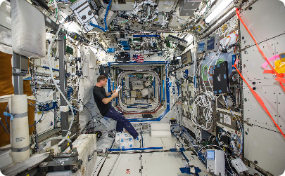

Meet Our Stellar Team
Astronauts
Engineers
Scientists
Our team of skilled astronauts who fearlessly embark on daring missions, pushing the boundaries of human exploration and paving the way for future space journeys.
Our brilliant engineers who design and build cutting-edge spacecraft, enabling us to reach the farthest reaches of the universe with precision and reliability.
Our accomplished scientists who analyze data collected from our missions, uncovering secrets of the cosmos and advancing our knowledge of the universe.

Slide 5
Our Expansive Reach
Mission
Partnerships
Private Ventures
We have successfully completed 100+ missions, spanning from lunar landings to deep space explorations.
We collaborate with leading space agencies and institutions worldwide, fostering cooperation and sharing resources to achieve extraordinary results.
We actively engage with private companies to leverage their innovation and expertise, forging a path towards the future of space exploration.

Slide 6
Celebrating Our Success Stories
1
Lunar Landing
In 2025, our team achieved a historic milestone by successfully landing the first human on the moon in over five decades!
Exoplanet Discovery
2
In 2030, our space telescope detected a habitable exoplanet, providing a glimpse of the possibility of extraterrestrial life.
3
Uncovering Galactic Mysteries
In 2040, our deep space probe unlocked long-standing mysteries of the universe, revolutionizing our understanding of cosmic phenomena.

Slide 7

Join the Galactic Journey
1
Explore Career Opportunities 🌠
2
Partner with Us 🚀
3
Contact Us Today ☎️
Collaborate with Galactic to unlock new possibilities in research, technology, and space exploration. Let's create a better future together.
Have a question or want to learn more? Reach out to us via email or phone, and our team will be delighted to assist you.
Be part of our trailblazing team and contribute to groundbreaking space missions. Check out our career page for exciting job openings.

Slide 8
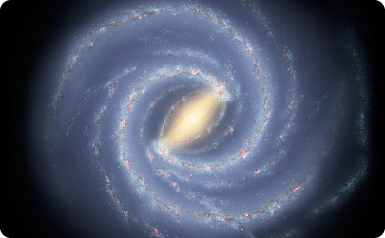


Experience the Wonder
Milky Way
Cosmic Nebulae
Exoplanets
Embark on an unforgettable journey through our galaxy. Witness the awe-inspiring beauty of the Milky Way with our immersive space tours.
Indulge in the captivating splendor of cosmic nebulae, vibrant clouds of dust and gas that unveil the mesmerizing birthplaces of stars.
Discover distant exoplanets, alien worlds beyond our solar system that hold the tantalizing potential for life beyond Earth.

